Slide 1
EIGRP
Routing Protocols and Concepts – Chapter 9

Slide 2
Objectives
Describe the background and history of Enhanced Interior Gateway Routing Protocol (EIGRP).
Examine the basic EIGRP configuration commands and identify their purposes.
Calculate the composite metric used by EIGRP.
Describe the concepts and operation of DUAL.
Describe the uses of additional configuration commands in EIGRP.

Slide 3
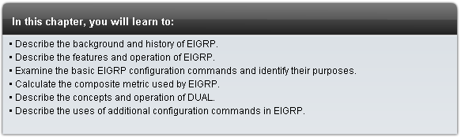
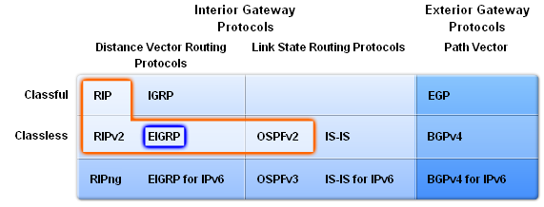
Introduction

Slide 4
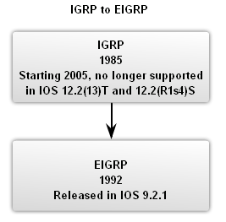
EIGRP
Roots of EIGRP: IGRP
  Developed in 1985 to overcome RIPv1’s limited hop count
  Distance vector routing protocol
  Metrics used by IGRP
    Bandwidth (used by default)
    Delay (used by default)
    Reliability
    Load
  Discontinued support starting with IOS 12.2(13)T & 12.2(R1s4)S

Slide 5
EIGRP
EIGRP Message Format
EIGRP Header
  Data link frame header - contains source and destination MAC address
  IP packet header - contains source & destination IP address
  EIGRP packet header - contains AS number
  Type/Length/Field - data portion of EIGRP message

Slide 6
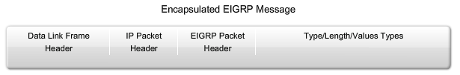
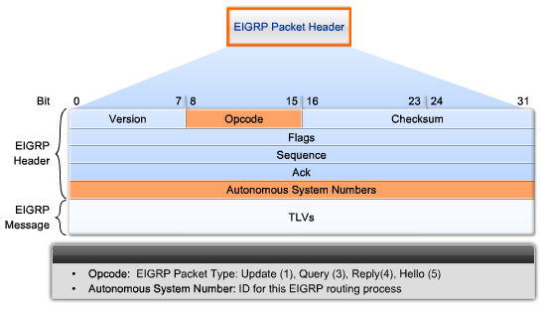
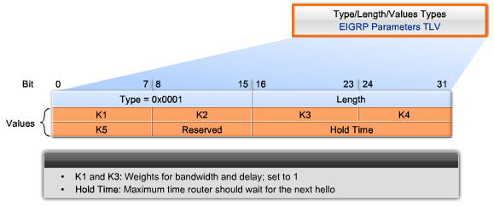
EIGRP
EIGRP packet header contains:
  Opcode field
  Autonomous System number
EIGRP Parameters contain:
  Weights
  Hold time

Slide 7
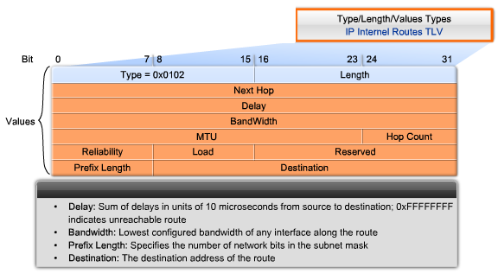
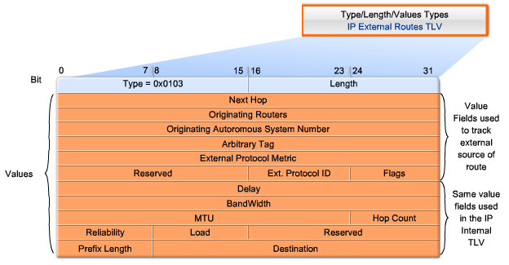
EIGRP
TLV: IP internal contains
  Metric field
  Subnet mask field
  Destination field
TLV: IP external contains
  Fields used when external routes are imported into EIGRP routing process

Slide 8
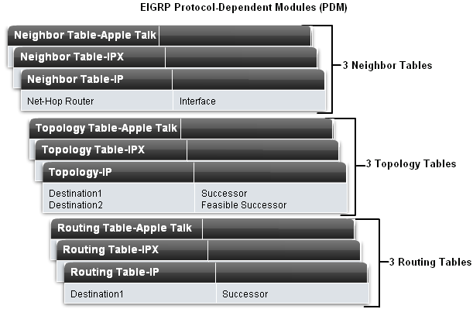
EIGRP
Protocol Dependent Modules (PDM)
  EIGRP uses PDM to route several different protocols i.e. IP, IPX & AppleTalk
  PDMs are responsible for the specific routing task for each network layer protocol

Slide 9
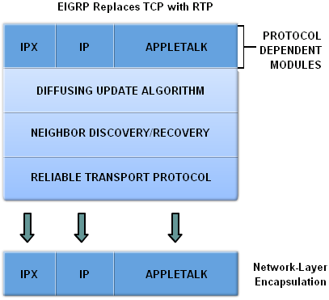
EIGRP
Reliable Transport Protocol (RTP)
Purpose of RTP
  Used by EIGRP to transmit and receive EIGRP packets
Characteristics of RTP
  Involves both reliable & unreliable delivery of EIGRP packet
    Reliable delivery requires acknowledgment from destination
    Unreliable delivery does not require an acknowledgement from destination
  Packets can be sent
    Unicast
    Multicast
      Using address 224.0.0.10

Slide 10
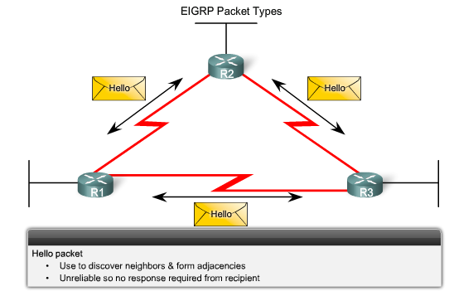
EIGRP
EIGRP’s 5 Packet Types
Hello packets
  Used to discover & form adjacencies with neighbors

Slide 11
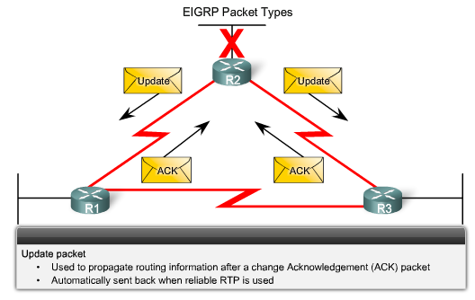
EIGRP
Update packets
  Used to propagate routing information

Slide 12
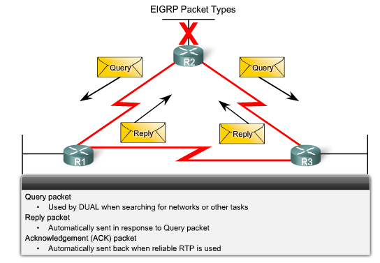
EIGRP
Query packets
  Used by DUAL for searching for networks
  Can use Unicast or Multicast
Reply packets
  Reply packet
  Can use Unicast only
Acknowledgement packets
  Used to acknowledge receipt of update, query & reply packets

Slide 13
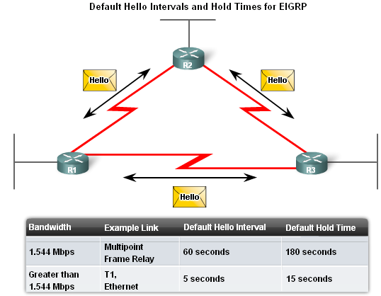
EIGRP
Purpose of Hello Protocol
  To discover & establish adjacencies with neighbor routers
Characteristics of hello protocol
  Time interval for sending hello packet
    Most networks it is every 5 seconds
    Multipoint non broadcast multi- access networks
      Unicast every 60 seconds
  Holdtime
    This is the maximum time router should wait before declaring a neighbor down
    Default holdtime
      3 times hello interval

Slide 14
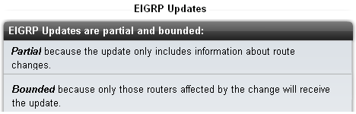
EIGRP
EIGRP Bounded Updates
  EIGRP only sends update when there is a change in route status
  Partial update
    A partial update includes only the route information that has changed – the whole routing table is NOT sent
  Bounded update
    When a route changes, only those devices that are impacted will be notified of the change
  EIGRP’s use of partial bounded updates minimizes use of bandwidth

Slide 15
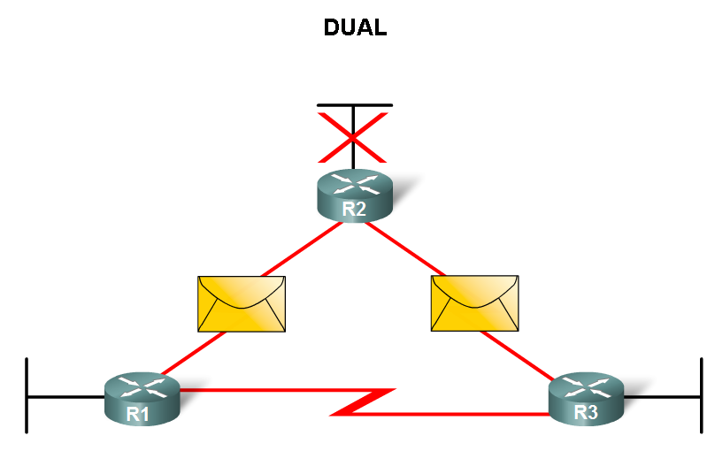
EIGRP
Diffusing Update Algorithm (DUAL)
  Purpose
    EIGRP’s primary method for preventing routing loops
  Advantage of using DUAL
    Provides for fast convergence time by keeping a list of loop-free backup routes

Slide 16
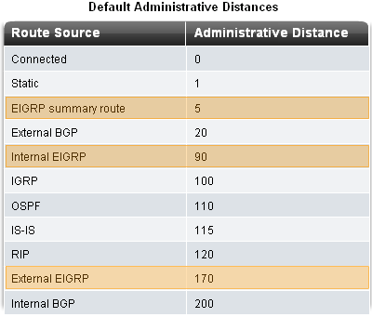
EIGRP
Administrative Distance (AD)
  Defined as the trustworthiness of the source route
EIGRP default administrative distances
  Summary routes = 5
  Internal routes = 90
  Imported routes = 170

Slide 17
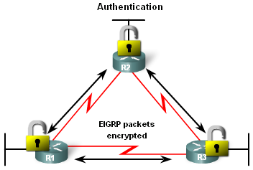
EIGRP
Authentication
  EIGRP can
    Encrypt routing information
    Authenticate routing information

Slide 18
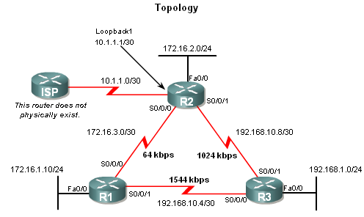
EIGRP
Network Topology
  Topology used is the same as previous chapters with the addition of an ISP router

Slide 19
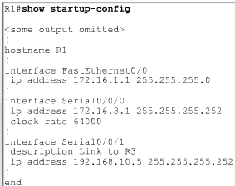
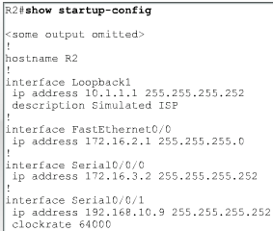
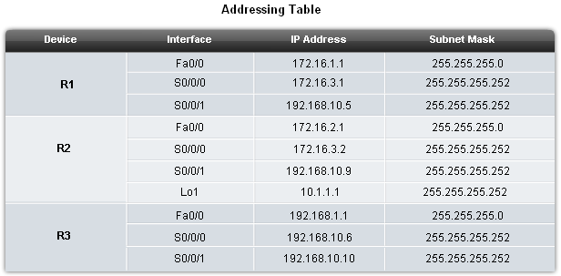
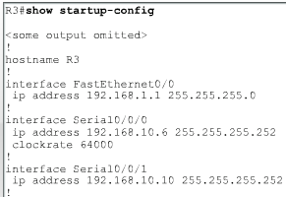
EIGRP
EIGRP will automatically summarize routes at classful boundaries

Slide 20
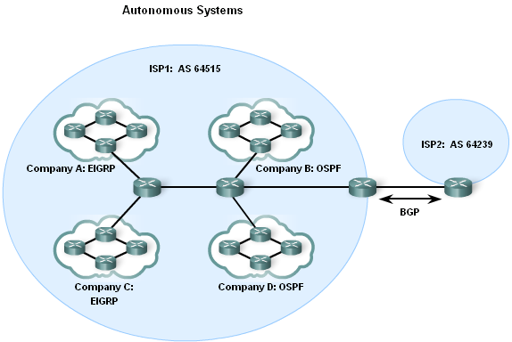
Basic EIGRP Configuration
Autonomous System (AS) & Process IDs
  This is a collection of networks under the control of a single authority (reference RFC 1930)
  AS Numbers are assigned by IANA
  Entities needing AS numbers
    ISP
    Internet Backbone prodiers
    Institutions connecting to other institutions using AS numbers

Slide 21
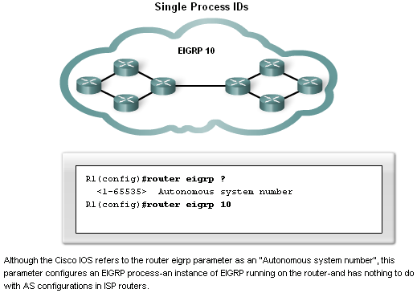
Basic EIGRP Configuration
EIGRP autonomous system number actually functions as a process ID
Process ID represents an instance of the routing protocol running on a router
Example
  Router(config)#router
    eigrp autonomous-system

Slide 22
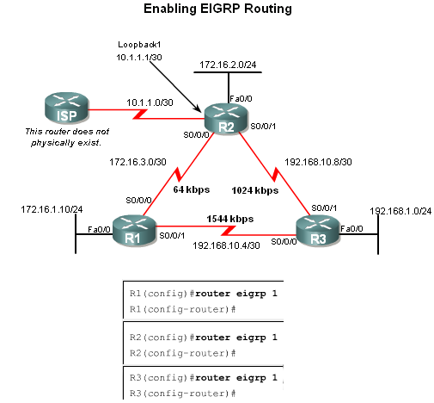
Basic EIGRP Configuration
The router eigrp command
The global command that enables eigrp is
  router eigrp autonomous-system
  All routers in the EIGRP routing domain must use the same process ID number (autonomous-system number)

Slide 23
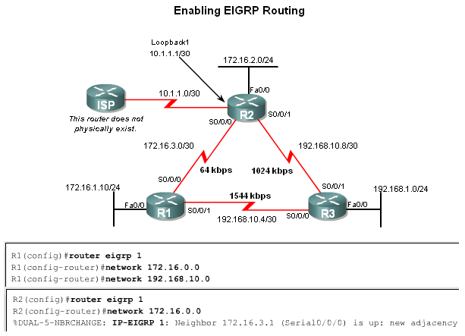
Basic EIGRP Configuration
The Network Command
Functions of the network command
  Enables interfaces to transmit & receive EIGRP updates
  Includes network or subnet in EIGRP updates
Example
  Router(config-router)#network network-address

Slide 24
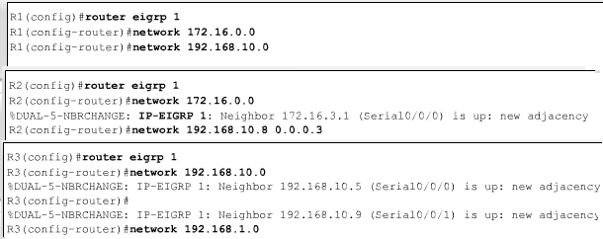
Basic EIGRP Configuration
The network Command with a Wildcard Mask
  This option is used when you want to configure EIGRP to advertise specific subnets
  Example
    Router(config-router)#network network-address [wildcard-mask]

Slide 25
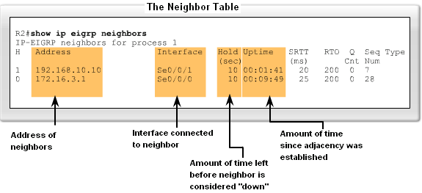
Basic EIGRP Configuration
Verifying EIGRP
  EIGRP routers must establish adjacencies with their neighbors before any updates can be sent or received
  Command used to view neighbor table and verify that EIGRP has established adjacencies with neighbors is
    show ip eigrp neighbors

Slide 26
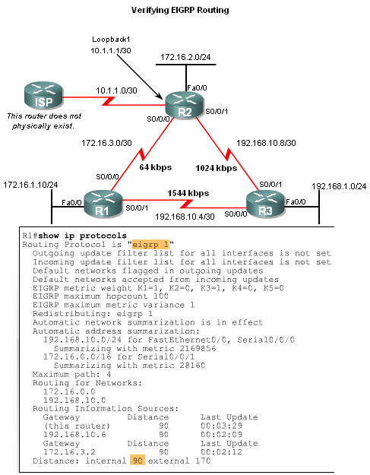
EIGRP
The show ip protocols command is also used to verify that EIGRP is enabled

Slide 27
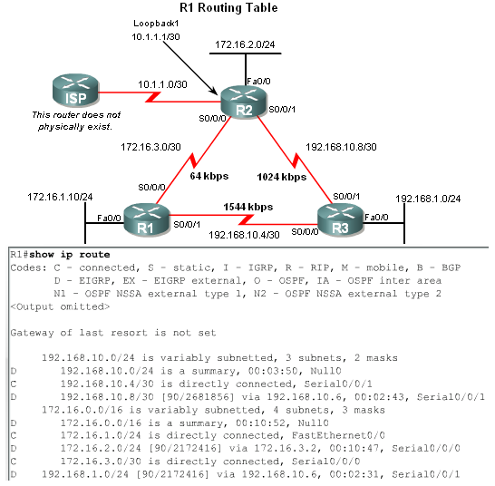
Basic EIGRP Configuration
Examining the Routing Table
  The show ip route command is also used to verify EIGRP
  EIGRP routes are denoted in a routing table by the letter “D”
  By default , EIGRP automatically summarizes routes at major network boundary

Slide 28
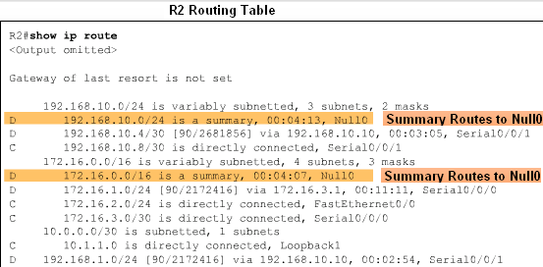
Basic EIGRP Configuration
Introducing the Null0 Summary Route
  Null0 is not a physical interface
  In the routing table summary routes are sourced from Null0
    Reason: routes are used for advertisement purposes
  EIGRP will automatically include a null0 summary route as child route when 2 conditions are met
    At least one subnet is learned via EIGRP
    Automatic summarization is enabled

Slide 29
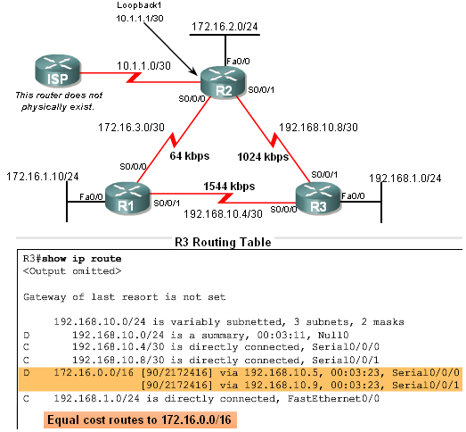
Basic EIGRP Configuration
R3’s routing table shows that the 172.16.0.0/16 network is automatically summarized by R1 & R3

Slide 30
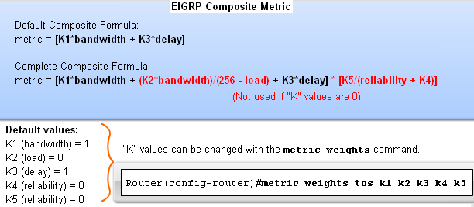
EIGRP Metric Calculation
EIGRP Composite Metric & the K Values
  EIGRP uses the following values in its composite metric
    Bandwidth, delay, reliability, and load
  The composite metric used by EIGRP
    Formula used has values K1 →K5
      K1 & K3 = 1
      all other K values = 0

Slide 31
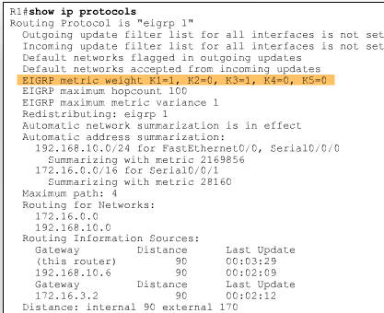
EIGRP Metric Calculation
Use the sh ip protocols command to verify the K values

Slide 32
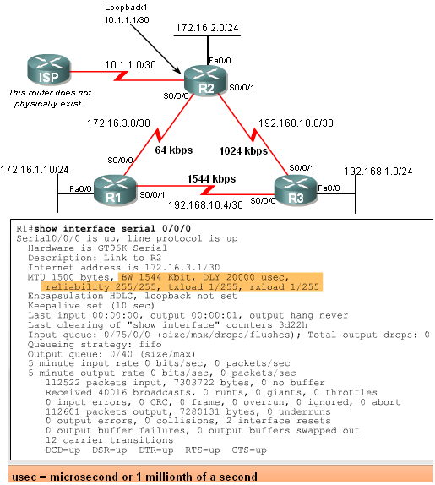
EIGRP Metric Calculation
EIGRP Metrics
  Use the show interfaces command to view metrics
  EIGRP Metrics
    Bandwidth – EIGRP uses a static bandwidth to calculate metric
    Most serial interfaces use a default bandwidth value of 1.544Mbos (T1)

Slide 33
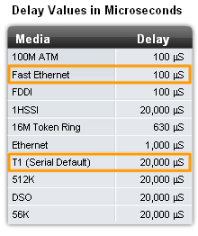
EIGRP Metric Calculation
EIGRP Metrics
  Delay is the defined as the measure of time it takes for a packet to traverse a route
    It is a static value based on link type to which interface is connected

Slide 34
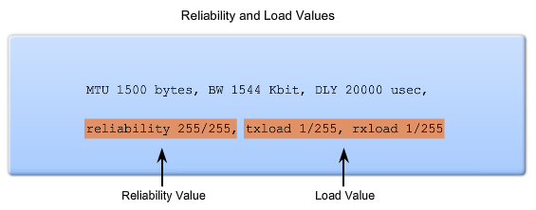
EIGRP Metric Calculation
Reliability (not a default EIGRP metric)
  A measure of the likelihood that a link will fail
  Measure dynamically & expressed as a fraction of 255 the higher the fraction the better the reliability
Load (not a default EIGRP metric)
  A number that reflects how much traffic is using a link
  Number is determined dynamically and is expressed as a fraction of 255
    The lower the fraction the less the load on the link

Slide 35
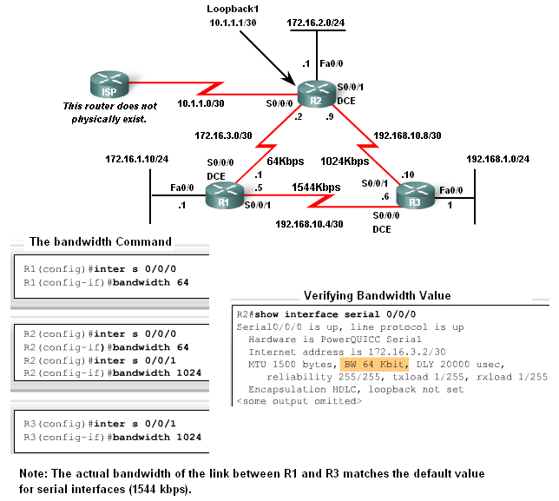
EIGRP Metric Calculation
Using the Bandwidth Command
  Modifying the interface bandwidth
    Use the bandwidth command
    Example
    Router(config-if)#bandwidth kilobits
  Verifying bandwidth
    Use the show interface command
  Note – bandwidth command does not change the link’s physical bandwidth

Slide 36
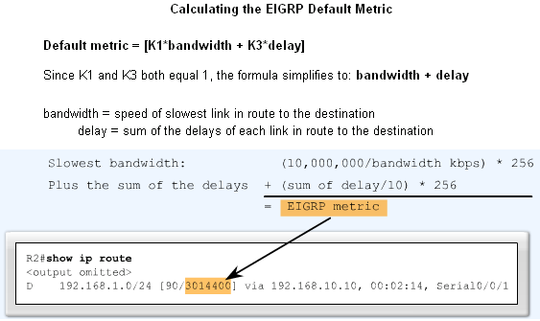
EIGRP Metric Calculation
The EIGRP metric can be determined by examining the bandwidth delay

Slide 37
EIGRP Metric Calculation
EIGRP uses the lowest bandwidth (BW)in its metric calculation
  Calculated BW = reference BW / lowest BW(kbps)
Delay – EIGRP uses the cumulative sum of all outgoing interfaces
  Calculated Delay = the sum of outgoing interface delays
EIGRP Metric = calculated BW + calculated delay

Slide 38
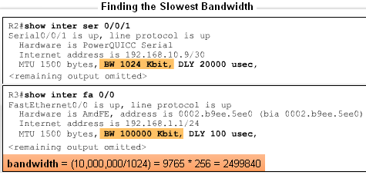
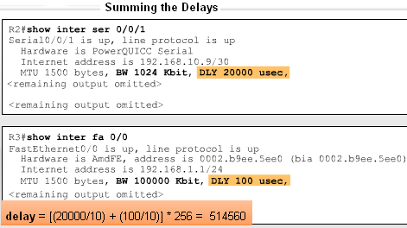
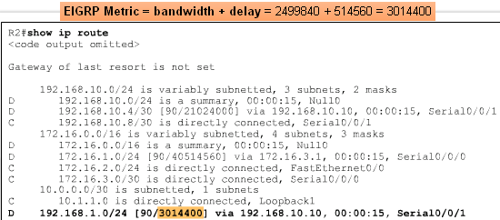
EIGRP Metric Calculation

Slide 39
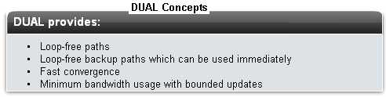
DUAL Concepts
The Diffusing Update Algorithm (DUAL) is used to prevent looping

Slide 40
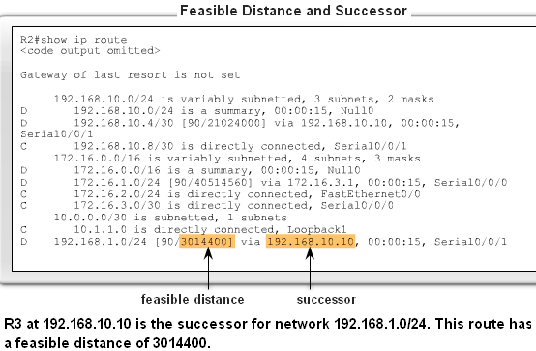
DUAL Concepts
Successor
  The best least cost route to a destination found in the routing table
Feasible distance
  The lowest calculated metric along a path to a destination network

Slide 41
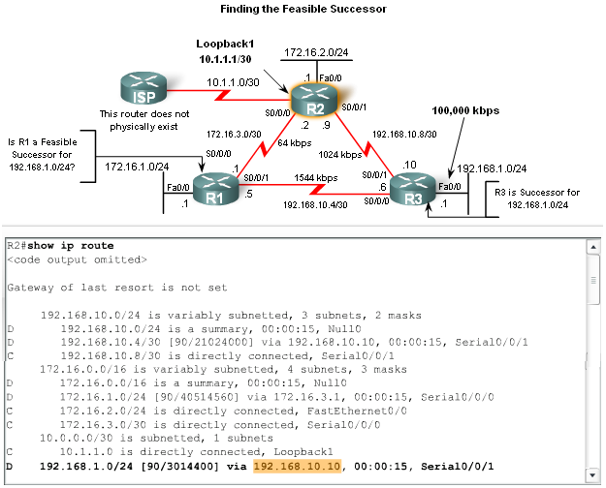
DUAL Concepts
Feasible Successors, Feasibility Condition & Reported Distance
Feasible Successor
  This is a loop free backup route to same destination as successor route

Slide 42
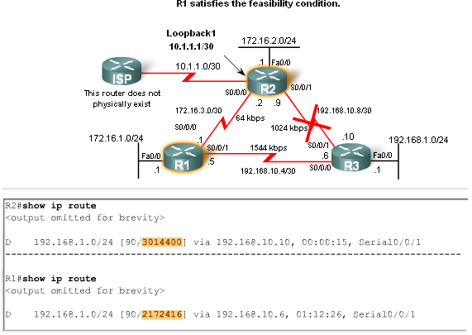
DUAL Concepts
Feasible Successors, Feasibility Condition & Reported Distance
Reported distance (RD)
  The metric that a router reports to a neighbor about its own cost to that network

Slide 43
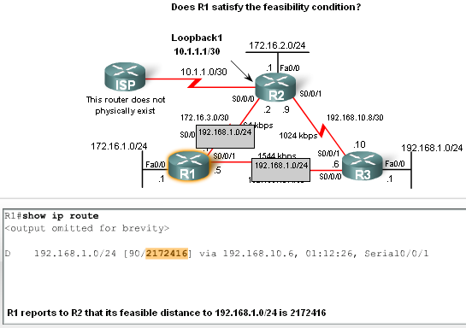
DUAL Concepts
Feasibility Condition (FC)
  Met when a neighbor’s RD is less than the local router’s FD to the same destination network

Slide 44
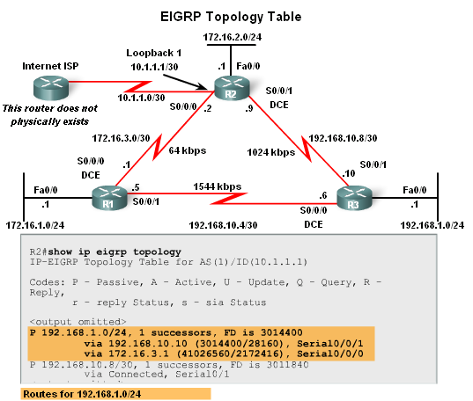
DUAL Concepts
Topology Table: Successor & Feasible Successor
EIGRP Topology table
  Viewed using the show ip eigrp topology command
    Contents of table include:
      all successor routes
      all feasible successor routes

Slide 45
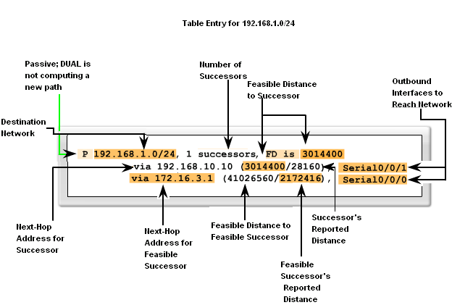
DUAL Concepts
EIGRP Topology Table dissected

Slide 46

DUAL Concepts
Topology Table: No Feasible Successor
A feasible successor may not be present because the feasibility condition may not be met
  In other words, the reported distance of the neighbor is greater than or equal to the current feasible distance

Slide 47
DUAL Concepts
Finite Sate Machine (FSM)
  An abstract machine that defines a set of possible states something can go through, what event causes those states and what events result form those states
  FSMs are used to describe how a device, computer program, or routing algorithm will react to a set of input events

Slide 48

DUAL Concepts
DUAL FSM
  Selects a best loop-free path to a destination
  Selects alternate routes by using information in EIGRP tables

Slide 49

DUAL Concepts
Finite State Machines (FSM)
  To examine output from EIGRP’s finite state machine us the debug eigrp fsm command

Slide 50
More EIGRP Configurations
The Null0 Summary Route
  By default, EIGRP uses the Null0 interface to discard any packets that match the parent route but do not match any of the child routes
  EIGRP automatically includes a null0 summary route as a child route whenever both of the following conditions exist
    One or subnets exists that was learned via EIGRP
    Automatic summarization is enabled

Slide 51

More EIGRP Configurations
The Null0 Summary Route

Slide 52
More EIGRP Configurations
Disabling Automatic Summarization
  The auto-summary command permits EIGRP to automatically summarize at major network boundaries
  The no auto-summary command is used to disable automatic summarization
    This causes all EIGRP neighbors to send updates that will not be automatically summarized
      This will cause changes to appear in both
        routing tables
        topology tables

Slide 53
More EIGRP Configurations
Manual Summarization
  Manual summarization can include supernets
    Reason: EIGRP is a classless routing protocol & include subnet mask in update
  Command used to configure manual summarization
    Router(config-if)#ip summary-address eigrp as-number network-address subnet-mask

Slide 54

More EIGRP Configurations
Configuring a summary route in EIGRP

Slide 55
More EIGRP Configurations
EIGRP Default Routes
  “Quad zero” static default route
    Can be used with any currently supported routing protocol
    Is usually configured on a router that is connected a network outside the EIGRP domain
  EIGRP & the “Quad zero” static default route
    Requires the use of the redistribute static command to disseminate default route in EIGRP updates

Slide 56

More EIGRP Configurations
Fine-Tuning EIGRP
  EIGRP bandwidth utilization
    By default, EIGRP uses only up to 50% of interface bandwidth for EIGRP information
    The command to change the percentage of bandwidth used by EIGRP is
      Router(config-if)#ip bandwidth-percent eigrp as-number percent

Slide 57

More EIGRP Configurations
Configuring Hello Intervals and Hold Times
  Hello intervals and hold times are configurable on a per-interface basis
  The command to configure hello interval is
    Router(config-if)#ip hello-interval eigrp as-number seconds
Changing the hello interval also requires changing the hold time to a value greater than or equal to the hello interval
  The command to configure hold time value is
    Router(config-if)#ip hold-time eigrp as-number seconds

Slide 58
Summary
Background & History
  EIGRP is a derivative of IGRP
    EIGRP is a Cisco proprietary distance vector routing protocol released in 1994
EIGRP terms and characteristics
  EIGPR uses RTP to transmit & receive EIGRP packets
  EIGRP has 5 packet type:
    Hello packets
    Update packets
    Acknowledgement packets
    Query packets
    Reply packets
  Supports VLSM & CIDR

Slide 59
Summary
EIGRP terms and characteristics
  EIGRP uses a hello protocol
    Purpose of hello protocol is to discover & establish adjacencies
  EIGRP routing updates
    Aperiodic
    Partial and bounded
    Fast convergence

Slide 60
Summary
EIGRP commands
  The following commands are used for EIGRP configuration
    RtrA(config)#router eigrp [autonomous-system #]
    RtrA(config-router)#network network-number
  The following commands can be used to verify EIGRP
    Show ip protocols
    Show ip eigrp neighbors
    Show ip route

Slide 61
Summary
EIGRP metrics include
  Bandwidth (default)
  Delay (default)
  Reliability
  Load

Slide 62
Summary
DUAL
  Purpose of DUAL
    To prevent routing loops
  Successor
    Primary route to a destination
  Feasible successor
    Backup route to a destination
  Feasible distance
    Lowest calculated metric to a destination
  Reported distance
    The distance towards a destination as advertised by an upstream neighbor

Slide 63
Summary
Choosing the best route
  After router has received all updates from directly connected neighbors, it can calculate its DUAL
    1st metric is calculated for each route
    2nd route with lowest metric is designated successor & is placed in routing table
    3rd feasible successor is found
      Criteria for feasible successor: it must have lower reported distance to the destination than the installed route’s feasible distance
      Feasible routes are maintained in topology table

Slide 64
Summary
Automatic summarization
  On by default
  Summarizes routes on classful boundary
  Summarization can be disabled using the following command
    RtrA(config-if)#no auto-summary

